Slide 1
Database System Concepts
Chapter 6: formal relational query languages

Slide 2
Relational Algebra
Procedural language
Six basic operators
  select: σ
  project: ∏
  union: ∪
  set difference: –
  Cartesian product: x
  rename: ρ
The operators take one or two relations as inputs and produce a new relation as a result.
Notes:
四则运算

Slide 3

Selection of tuples
Relation r
Select tuples with A=B and D > 5
σ _{A=B ∧ D > 5} (r)

Slide 4
Select Operation
Notation: σ_{p}(r)
p is called the selection predicate
Defined as:
σ_{p}(r) = {t | t ∈ r and p(t)}
Where p is a formula in propositional calculus consisting of terms connected by : ∧ (and), ∨ (or), ¬ (not). Each term is one of:
<attribute> op <attribute>or<constant>
where op is one of: =, ≠, >, ≥. <. ≤
Example of selection: σ _{dept_name=“Physics”} (instructor)

Slide 5

Project Operation
Relation r:
Select A and C
  Projection
  Π _{A, C} (r)

Slide 6

Project Operation
Notation:
A₁, ..., A_{k} are attribute names and r is a relation name
The result is defined as the relation of k columns obtained by erasing the columns that are not listed
Duplicate rows removed from result, since relations are sets
Example: To eliminate the dept_name attribute of instructor
∏_{ID, name, salary} (instructor)

Slide 7

Joining two relations – Cartesian Product
Relations r, s:
r x s:
Notes:
笛卡尔坐标系，结果有可能很大

Slide 8

Union of two relations
Relations r, s:
r ∪ s:

Slide 9
Union Operation
Notation: r ∪ s
Defined as: r ∪ s = {t | t ∈ r or t ∈ s}
For r ∪ s to be valid.
1. r, s must have the same arity (same number of attributes)
2. The attribute domains must be compatible

Slide 10
Union Operation
Example: to find all courses taught in the Fall 2009 semester, or in the Spring 2010 semester, or in both
∏_{course_id} (σ _{semester=“Fall” Λ year=2009} (section)) ∪
∏_{course_id} (σ _{semester=“Spring” Λ year=2010} (section))

Slide 11

Set difference of two relations
Relations r, s:
r – s:

Slide 12

Rename Operation
Allows us to name, and therefore to refer to, the results of relational-algebra expressions.
Example: ρ _{x} (E)
returns the expression E under the name X
If a relational-algebra expression E has arity n, then
returns the result of expression E under the name X, and with the attributes renamed to A₁ , A₂ , …., A_{n} .

Slide 13
Example Query
Find the largest salary in the university
  Step 1: find instructor salaries that are less than some other instructor salary (i.e. not maximum)
      using a copy of instructor under a new name d
    ∏_{instructor.salary} (σ _{instructor.salary < d.salary}
    (instructor x ρ_{d} (instructor)))

Slide 14
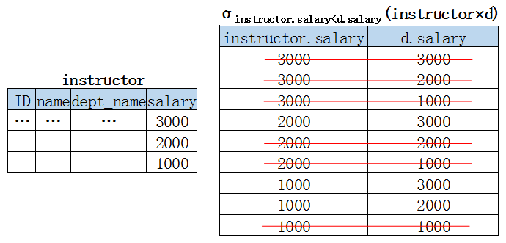

Slide 15
Example Query (cont.)
Find the largest salary in the university
  Step 2: Find the largest salary
    ∏_{salary} (instructor) –
    ∏_{instructor.salary} (σ _{instructor.salary < d.salary}
    (instructor x ρ_{d} (instructor)))

Slide 16
Example Queries
Find the names of all instructors in the Physics department, along with the course_id they have taught
  Query 1
  ∏_{instructor.ID,course_id} (σ_{dept_name=“Physics”} (
  σ _{instructor.ID=teaches.ID} (instructor x teaches)))
  Query 2
  ∏_{instructor.ID,course_id} (σ_{instructor.ID=teaches.ID} (
  σ _{dept_name=“Physics”} (instructor) x teaches))
Notes:
实际应用中直接用乘积比较少，属性名相同

Slide 17
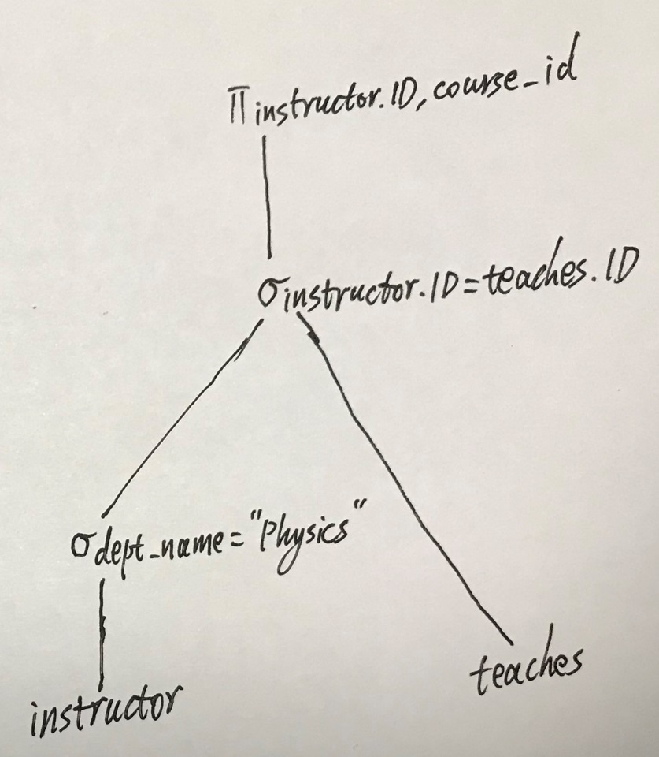
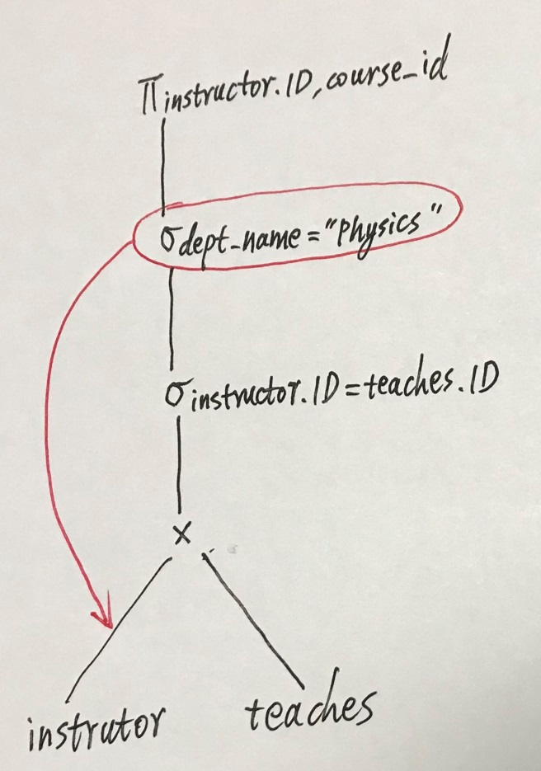
  ∏_{instructor.ID,course_id} (σ_{dept_name=“Physics”} (
  σ _{instructor.ID=teaches.ID} (instructor x teaches)))
  ∏_{instructor.ID,course_id} (σ_{instructor.ID=teaches.ID} (
  σ _{dept_name=“Physics”} (instructor) x teaches))

Slide 18
Formal Definition
A basic expression in the relational algebra consists of either one of the following:
  A relation in the database
  A constant relation

Slide 19
Formal Definition (cont.)
Let E₁ and E₂ be relational-algebra expressions; the following are all relational-algebra expressions:
  E₁ ∪ E₂
  E₁ – E₂
  E₁ x E₂
  σ_{p} (E₁), P is a predicate on attributes in E₁
  ∏_{s}(E₁), S is a list of some attributes in E₁
  ρ _{x} (E₁), x is the new name for the result of E₁

Slide 20
Additional Operations
We define additional operations that do not add any power to the relational algebra, but that simplify common queries.
Set intersection
Natural join
Assignment
Outer join

Slide 21

Set Intersection of two relations
Relation r, s:
r ∩ s
r ∩ s = r - (r - s)

Slide 22
Joining two relations – Natural Join
Notation: r s
Let r and s be relations on schemas R and S respectively. Then, the “natural join” of relations R and S is a relation on schema R ∪ S obtained as follows:
  Consider each pair of tuples t_{r} from r and t_{s} from s.
  If t_{r} and t_{s} have the same value on each of the attributes in R ∩ S, add a tuple t to the result, where
    t has the same value as t_{r} on r
    t has the same value as t_{s} on s

Slide 23

Natural Join Example
Relations r, s:
Natural Join
  r s

Slide 24
Natural-Join Operation
Example:
  R = (A, B, C, D)
  S = (E, B, D)
  Result schema = (A, B, C, D, E)
  r s is defined as:
  ∏_{r.A, r.B, r.C, r.D, s.E} (σ_{r.B = s.B ∧ r.D = s.D} (r x s))

Slide 25
Natural Join
Find the names of all instructors in the Comp. Sci. department together with the course titles of all the courses that the instructors teach
  ∏ _{name, title} (σ _{dept_name=“Comp. Sci.”} (instructor teaches course))

Slide 26
Natural Join and Theta Join
Natural join is associative
  (instructor teaches) course is equivalent to
  instructor (teaches course)
Natural join is commutative
  instructor teaches is equivalent to
  teaches instructor
The theta join operation
  r _{θ} s = σ_{θ} (r x s)

Slide 27
Division Operation
r ÷ s
Notation:
Suited to queries that include the phrase “for all”.
Let r and s be relations on schemas R and S respectively
  R = (A₁, …, A_{m} , B₁, …, B_{n} )
  S = (B₁, …, B_{n})
  The result of r ÷ s is a relation on schema
  R – S = (A₁, …, A_{m})
  r ÷ s = { t | t ∈ ∏ _{R-S} (r) ∧ ∀ u ∈ s ( tu ∈ r ) }
  Where tu means the concatenation of tuples t and u to produce a single tuple

Slide 28
Division Operation – Example
Relations r, s:
A
B
B
α
α
α
β
γ
δ
δ
δ
∈
∈
β
1
2
3
1
1
1
3
4
6
1
2
1
2
s
r ÷ s:
A
α
β
r

Slide 29
Another Division Example
Relations r, s:
A
B
C
D
E
D
E
α
α
α
β
β
γ
γ
γ
a
a
a
a
a
a
a
a
α
γ
γ
γ
γ
γ
γ
β
a
a
b
a
b
a
b
b
1
1
1
1
3
1
1
1
a
b
1
1
s
r
r ÷ s:
A
B
C
α
γ
a
a
γ
γ

Slide 30
Division Operation (Cont.)
Property
  Let q = r ÷ s
  Then q is the largest relation satisfying q x s ⊆ r
Definition in terms of the basic algebra operation
Let r(R) and s(S) be relations, and let S ⊆ R
r ÷ s = ∏_{R-S} (r ) – ∏_{R-S} ( ( ∏_{R-S} (r ) x s ) – ∏_{R-S,S}(r ))
To see why
  ∏_{R-S,S} (r) simply reorders attributes of r
  ∏_{R-S} (∏_{R-S} (r ) x s ) – ∏_{R-S,S}(r) ) gives those tuples t in ∏_{R-S} (r ) such that for some tuple u ∈ s, tu ∉ r.

Slide 31
Assignment Operation
The assignment operation (←) provides a convenient way to express complex queries.
  Write query as a sequential program consisting of
    a series of assignments
    followed by an expression whose value is displayed as a result of the query.
  Assignment must always be made to a temporary relation variable.

Slide 32
Assignment Operation (cont.)
Example: Write r ÷ s as
temp1 ← ∏_{R-S} (r )
temp2 ← ∏_{R-S} ((temp1 x s ) – ∏_{R-S,S} (r ))
result = temp1 – temp2

Slide 33
Outer Join
An extension of the join operation that avoids loss of information.
Computes the join and then adds tuples from one relation that does not match tuples in the other relation to the result of the join by using null values

Slide 34
Outer Join – Example
Relation instructor
ID
name
dept_name
10101
12121
15151
Srinivasan
Wu
Mozart
Comp. Sci.
Finance
Music
悬挂元组
Relation teaches
ID
course_id
10101
12121
76766
CS-101
FIN-201
BIO-101

Slide 35
Outer Join – Example
Join: instructor teaches
ID
name
dept_name
course_id
10101
12121
Srinivasan
Wu
Comp. Sci.
Finance
CS-101
FIN-201
Left Outer Join: instructor teaches
ID
name
dept_name
course_id
10101
12121
15151
Srinivasan
Wu
Mozart
Comp. Sci.
Finance
Music
CS-101
FIN-201
null

Slide 36
Outer Join – Example
Right Outer Join: instructor teaches
ID
name
dept_name
course_id
10101
12121
76766
Srinivasan
Wu
null
Comp. Sci.
Finance
null
CS-101
FIN-201
BIO-101
Full Outer Join: instructor teaches
ID
name
dept_name
course_id
10101
12121
15151
76766
Srinivasan
Wu
Mozart
null
Comp. Sci.
Finance
Music
null
CS-101
FIN-201
null
BIO-101

Slide 37
Outer Join using Joins
Outer join can be expressed using basic operations
  e.g. r s can be written as
  (r s) U (r – ∏_{R}(r s)) x {(null, …, null)}

Slide 38
Null Values
Comparisons with null values return the special truth value: unknown
  If false was used instead of unknown, then not (A < 5) would not be equivalent to A >= 5
For duplicate elimination and grouping, null is treated like any other value, and two nulls are assumed to be the same

Slide 39
Null Values
Three-valued logic using the truth value unknown:
  OR: (unknown or true) = true,
  (unknown or false) = unknown
  (unknown or unknown) = unknown
  AND: (true and unknown) = unknown,
  (false and unknown) = false,
  (unknown and unknown) = unknown
  NOT: (not unknown) = unknown
Result of select predicate is treated as false if it evaluates to unknown

Slide 40
Extended Relational-Algebra-Operations
Generalized Projection
Aggregate Functions

Slide 41
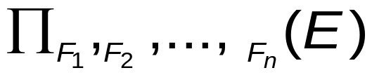
Generalized Projection
Extends the projection operation by allowing arithmetic functions to be used in the projection list.
Given relation instructor(ID, name, dept_name, salary) where salary is annual salary, get the same information but with monthly salary
∏_{ID, name, dept_name, salary/12} (instructor)

Slide 42
Aggregate Functions and Operations
Aggregation function takes a collection of values and returns a single value as a result.
avg: average value
min: minimum value
max: maximum value
sum: sum of values
count: number of values

Slide 43
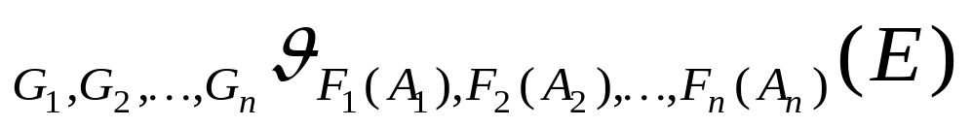

Aggregate Functions and Operations
Aggregate operation in relational algebra
E is any relational-algebra expression
  G₁, G₂ …, G_{n} is a list of attributes on which to group (can be empty)
  Each F_{i} is an aggregate function
  Each A_{i} is an attribute name

Slide 44
Aggregate Operation – Example
Relation r:
A
B
C
α
α
β
β
α
β
β
β
7
7
3
10
_{sum(c)} (r)
sum(c )
27

Slide 45


Aggregate Operation – Example
Find the average salary in each department _{dept_name} _{avg(salary)} (instructor)
avg_salary

Slide 46
Aggregate Functions (Cont.)
Result of aggregation does not have a name
  Can use rename operation to give it a name
  For convenience, we permit renaming as part of aggregate operation
_{dept_name} _{avg(salary) as avg_sal} (instructor)

Slide 47
Homework
6.11, 6.13

